Slide 1
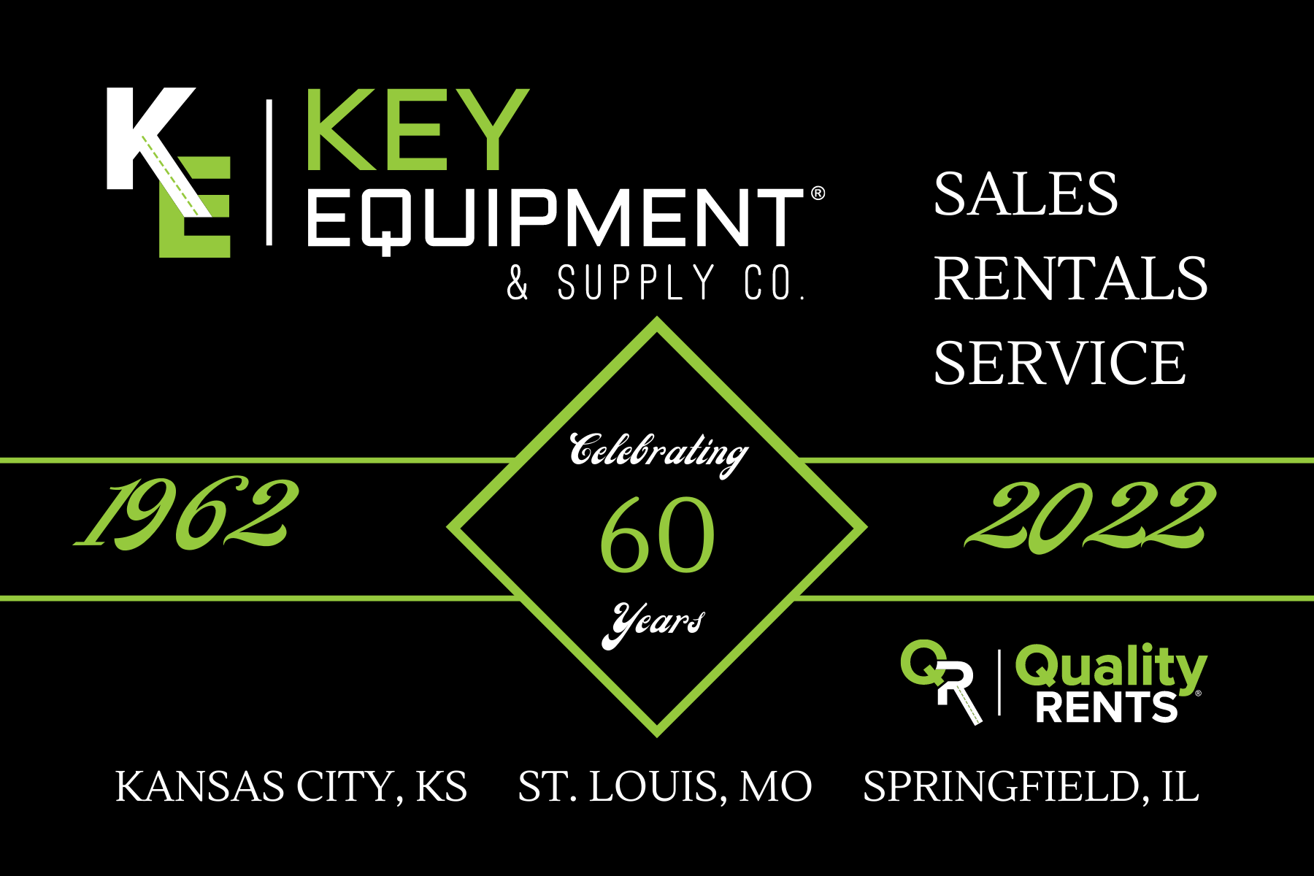

Slide 2



Brad Franklin
CENTRAL ILLINOIS
Providing support to contractor and municipal customers in the environmental industry for over 30 years.

Slide 3
Outline
What is Hydro Excavation?
Why is Vacuum Excavation important?
Regulations
Stats about strikes
Industry Best Practices
Tips
Other uses

Slide 4
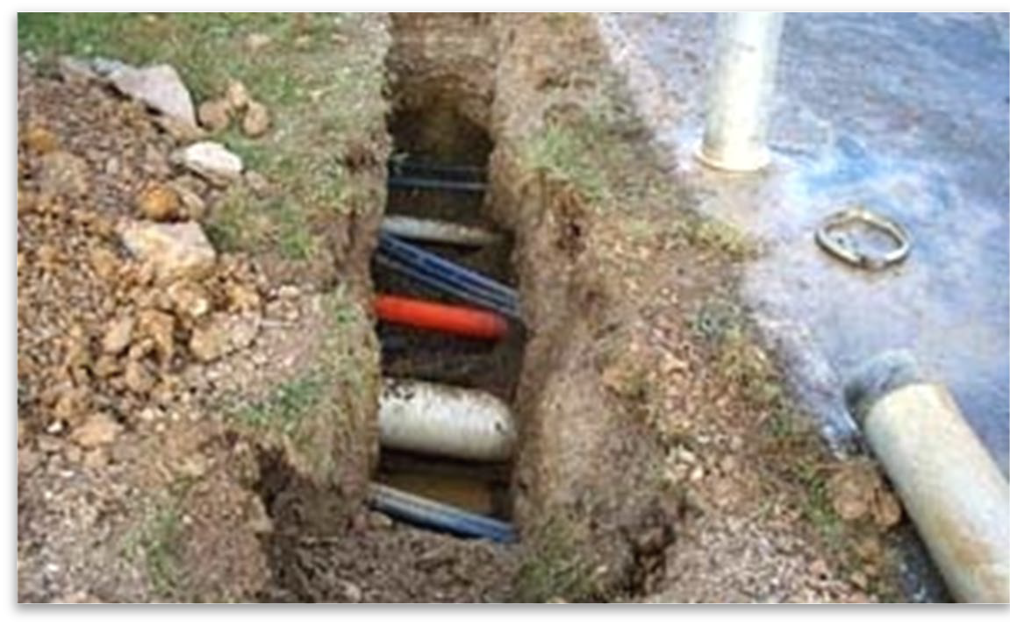
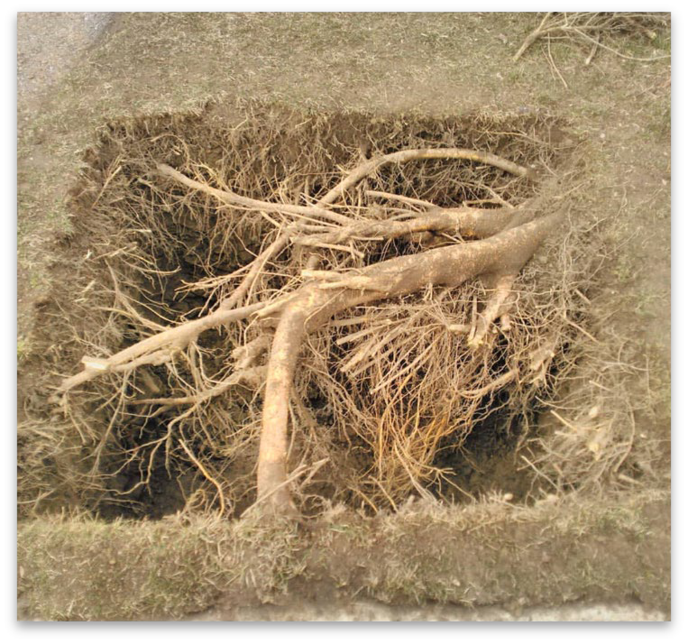
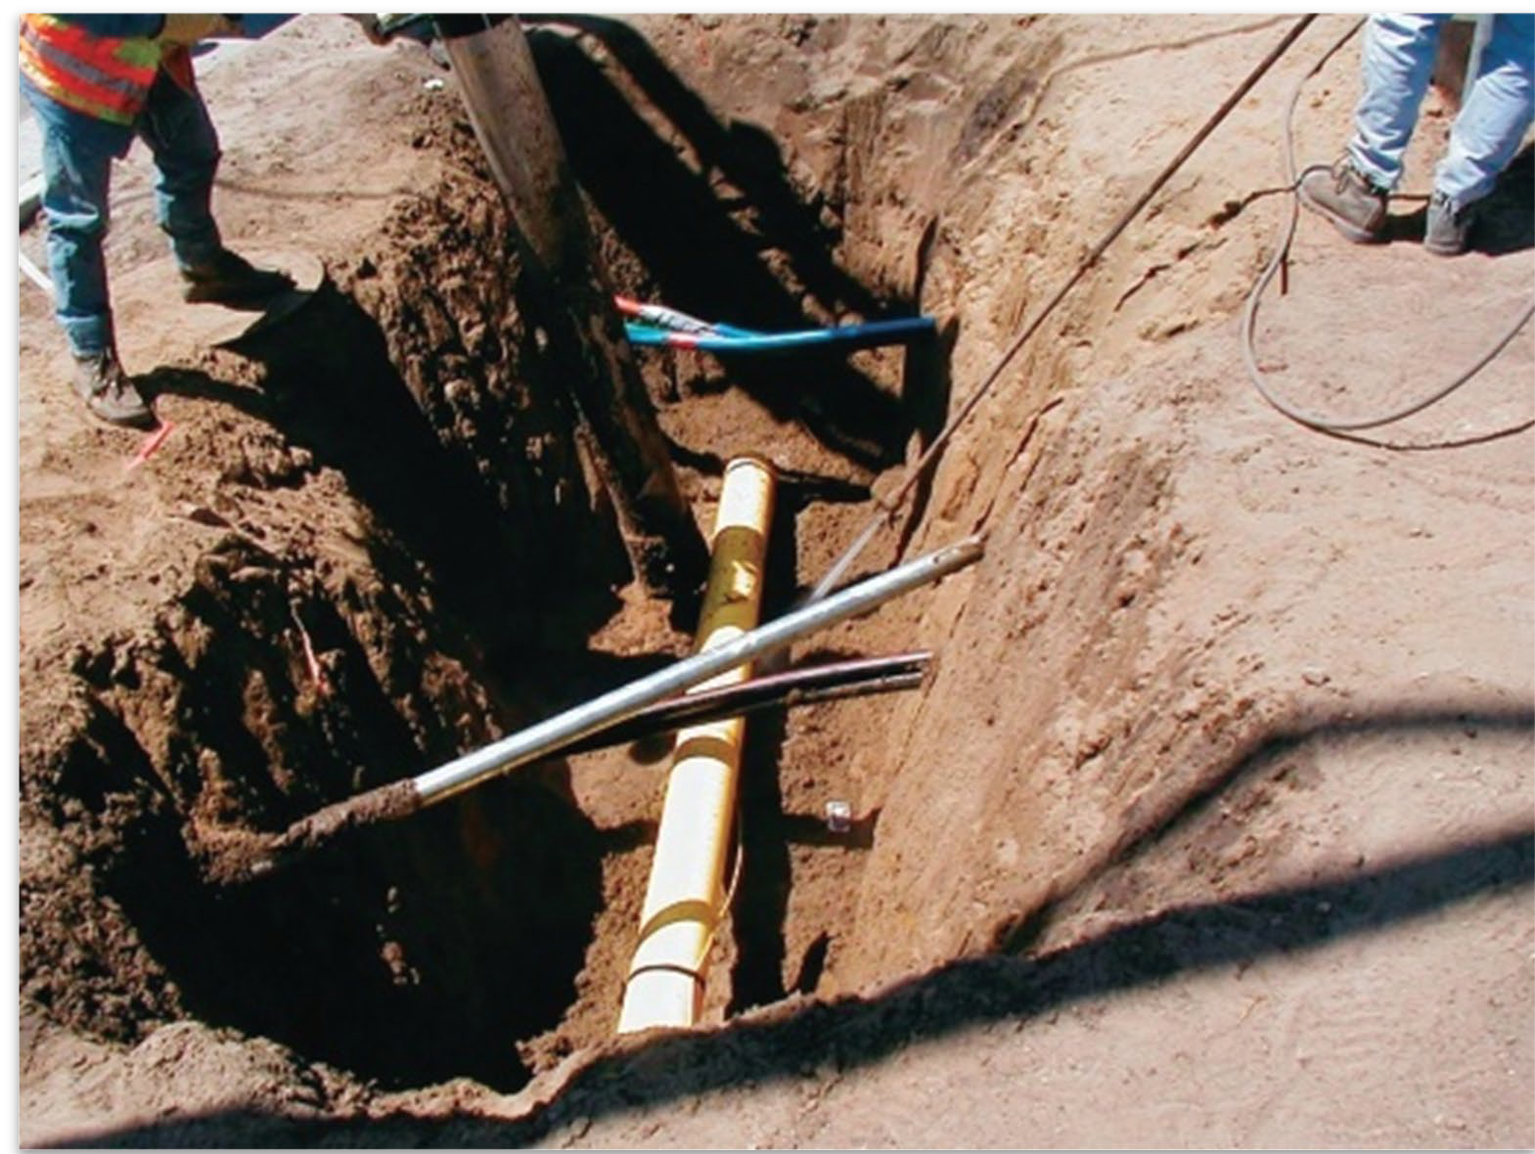
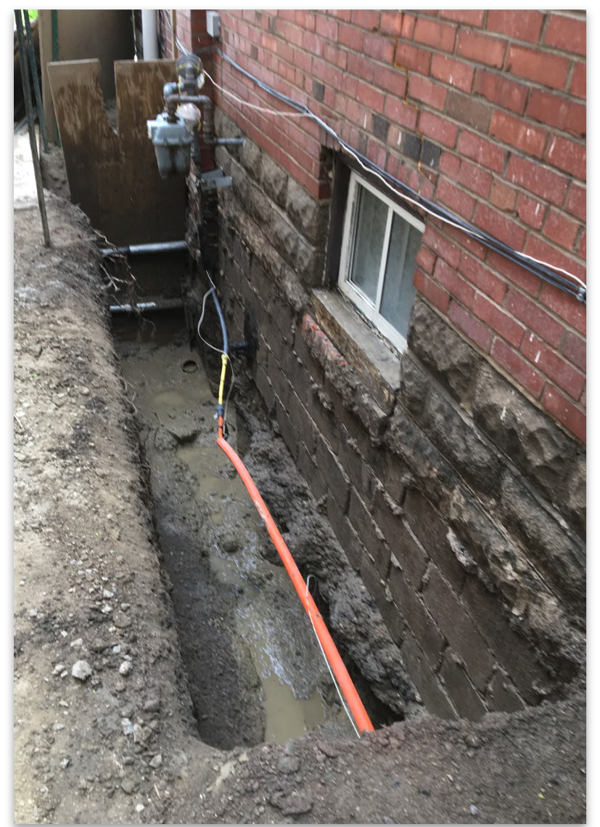
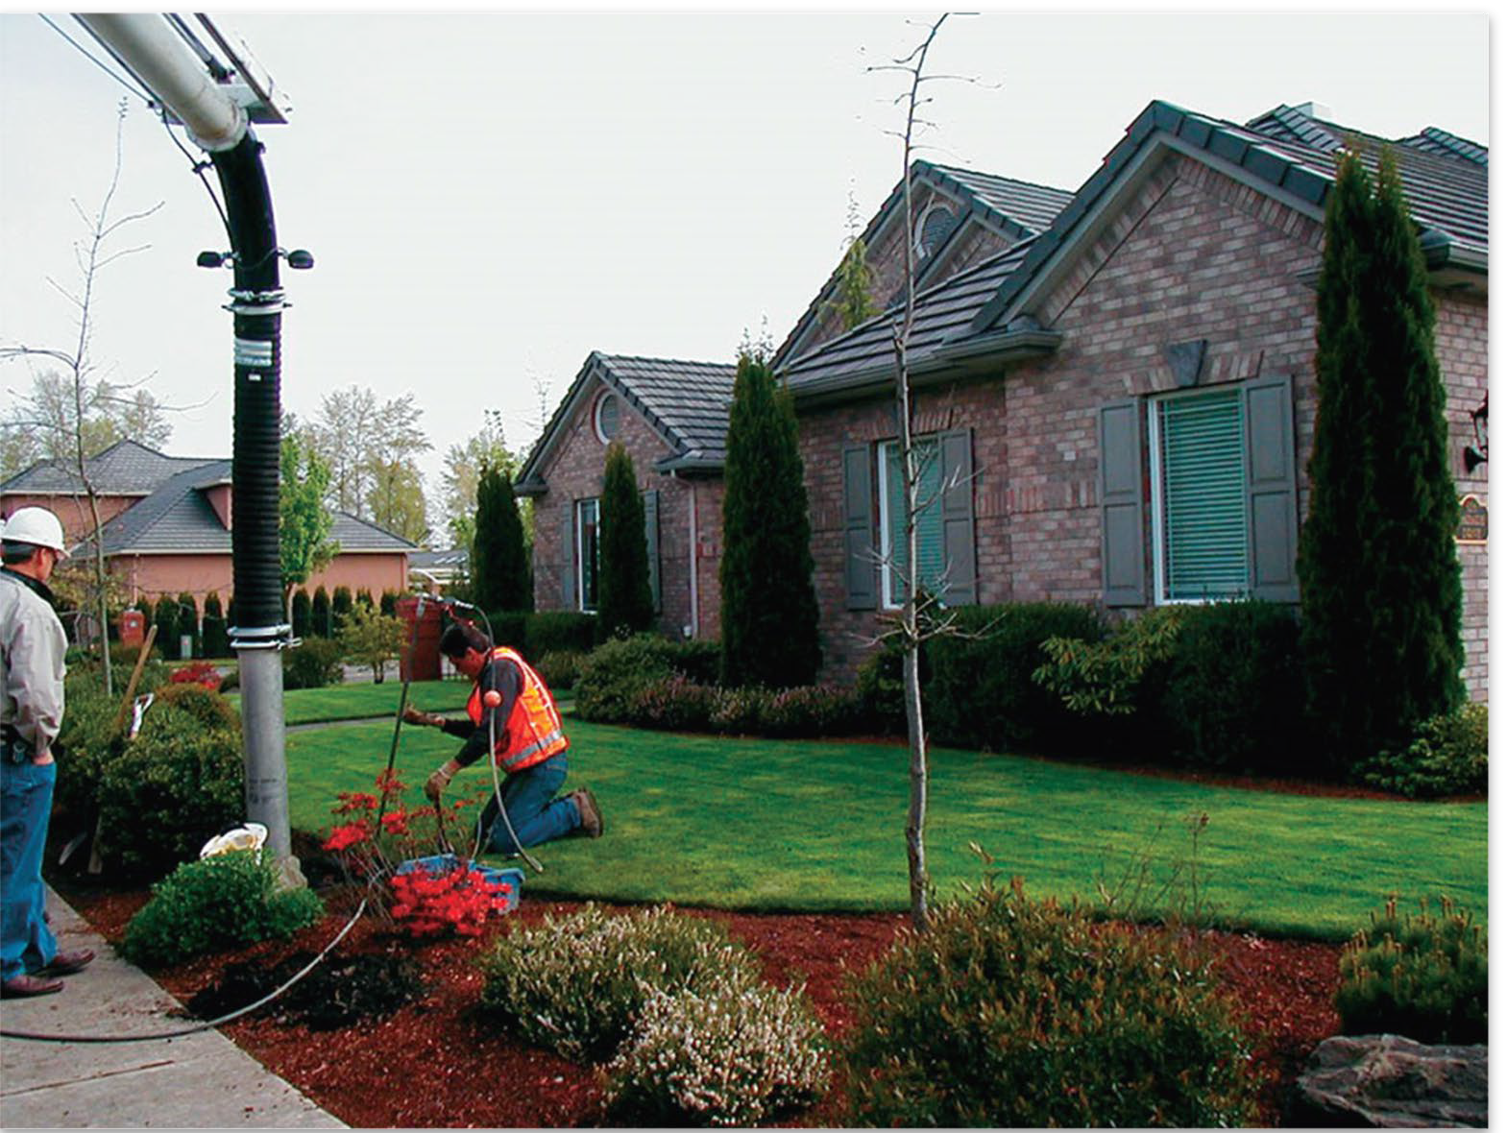
What is Vacuum Excavation?
Non-mechanical
Non-destructive
Safe visual verification of utility location
Precise excavation
Minimally disruptive

Slide 5
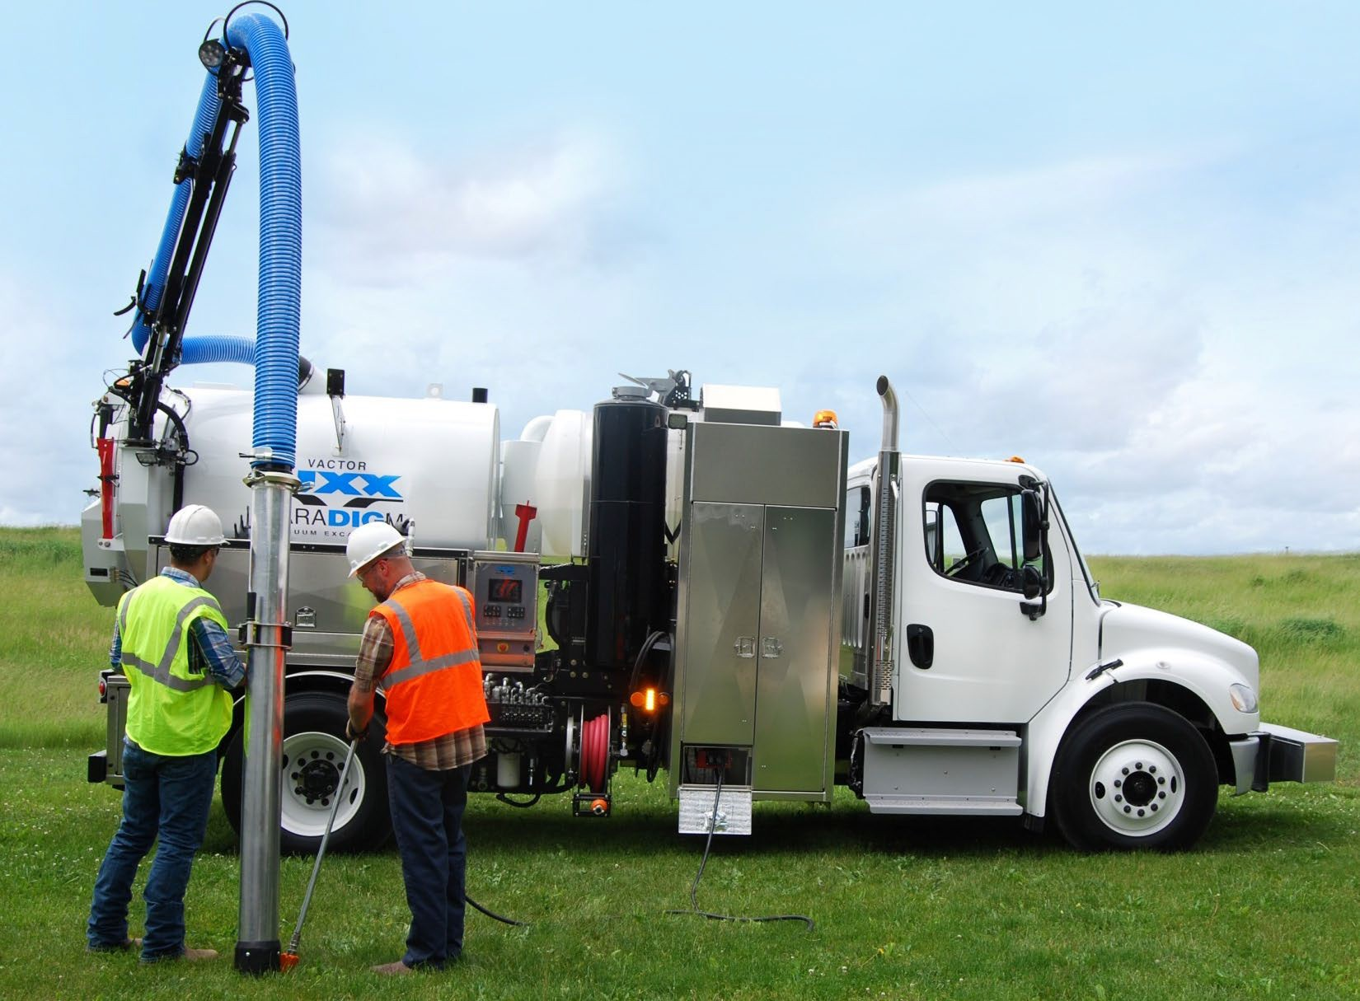
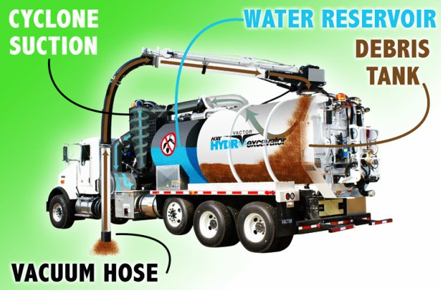
What is a Vacuum Excavator?
Debris Containment
Vacuum System (Fan or PD Blower)
Excavation Media (Compressed Air or Water)

Slide 6
History
Is Hydro Excavation new?

Slide 7

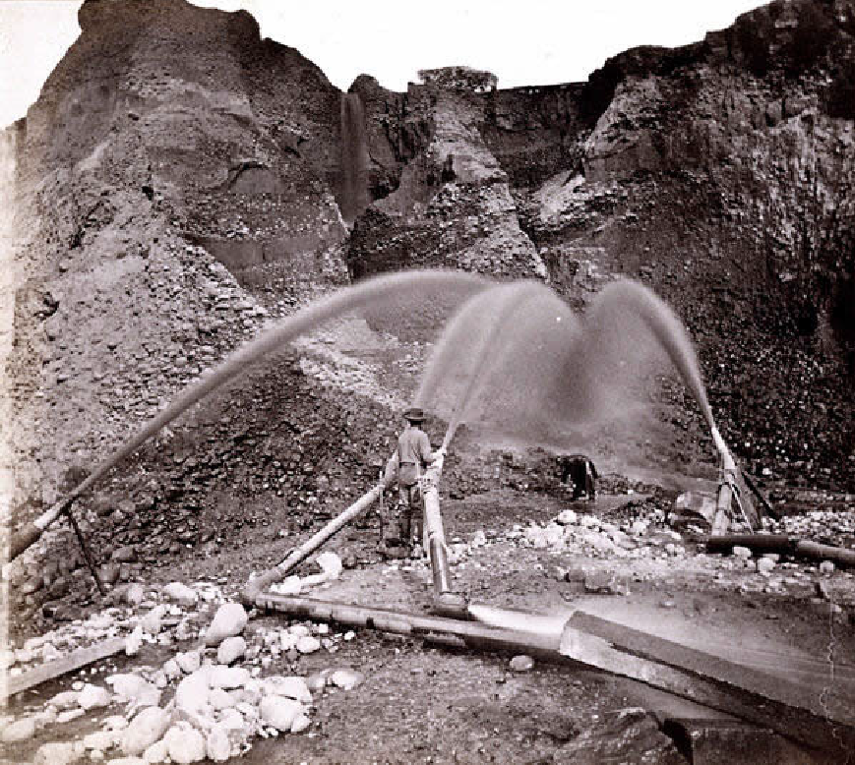
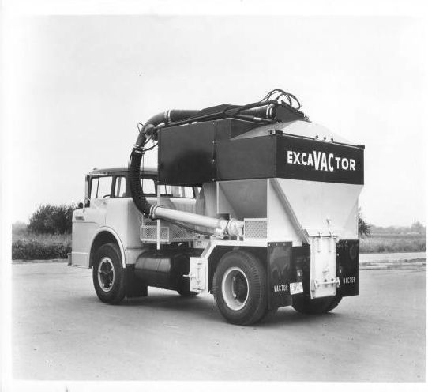
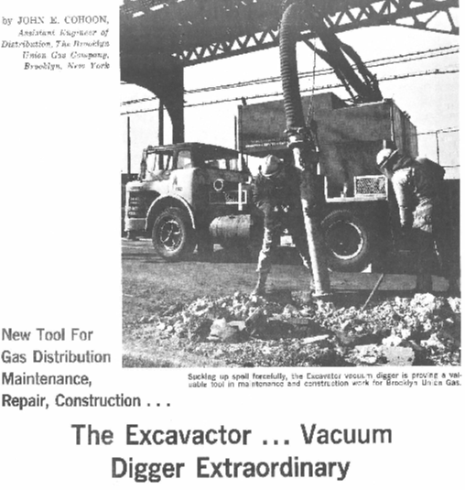
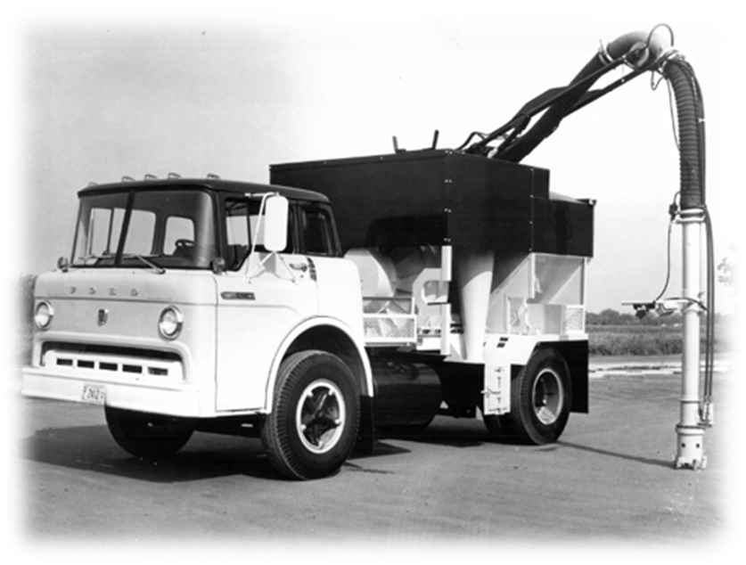
Is Hydro Excavation New?
Dating back to mid 1800’s miners used pressurized water to break up the terrain
1969 first dedicated hydro excavator, the Vactor ExcaVACtor

Slide 8

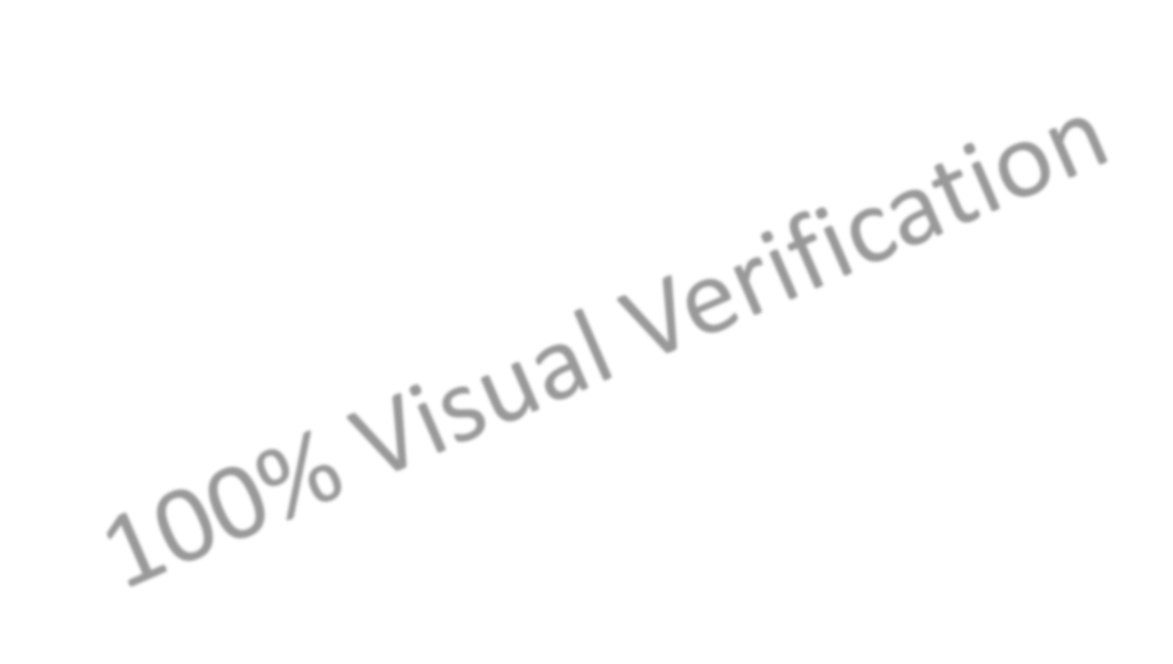

Vacuum Excavation-Necessity
First and foremost, protect your people
Congested utility easements
Protection of infrastructure
Increased productivity, no hand digging within tolerance zones
Mismarked, unmarked buried infrastructure
Regulation/Law/Recommendation changes
Risk mitigation
Safety
Notes:
Presenter
2021-03-02 21:53:29
--------------------------------------------
100% visual verification, precise-less site remediation, effective in all soil types/conditions, reduced traffic disruption, smaller site footprint, improved public perception

Slide 9
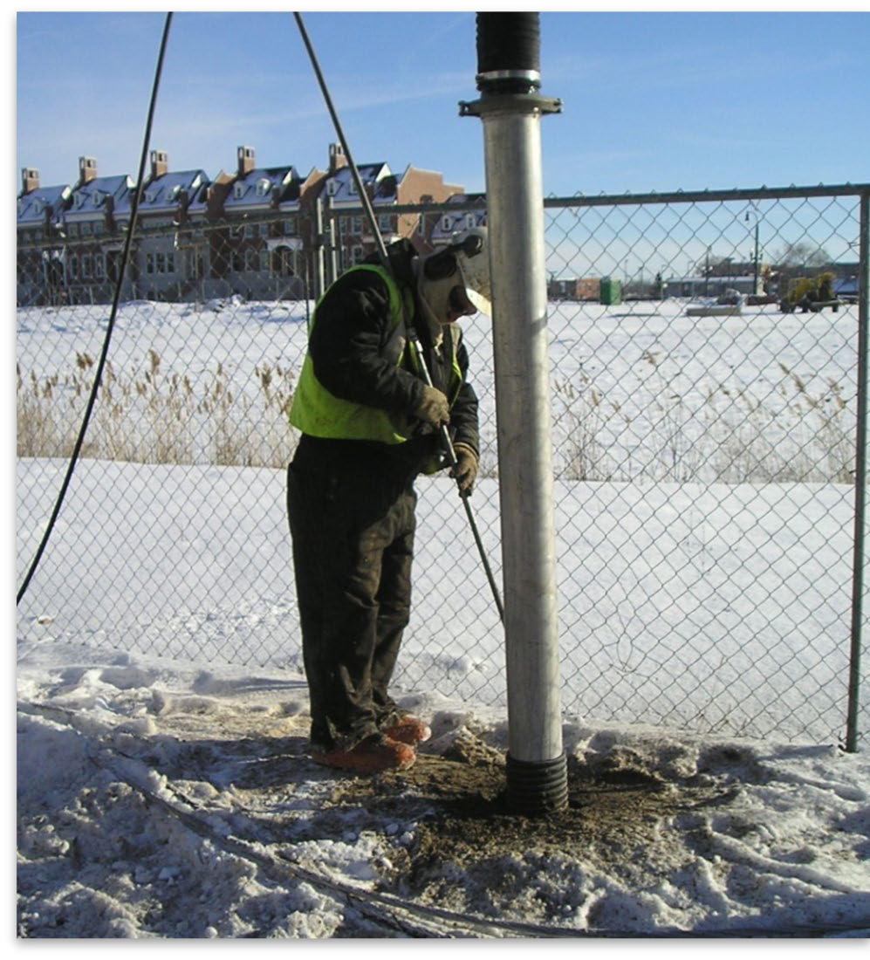
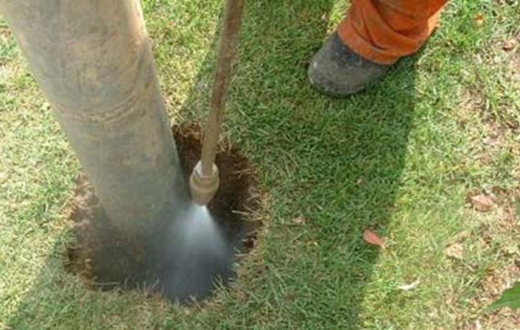
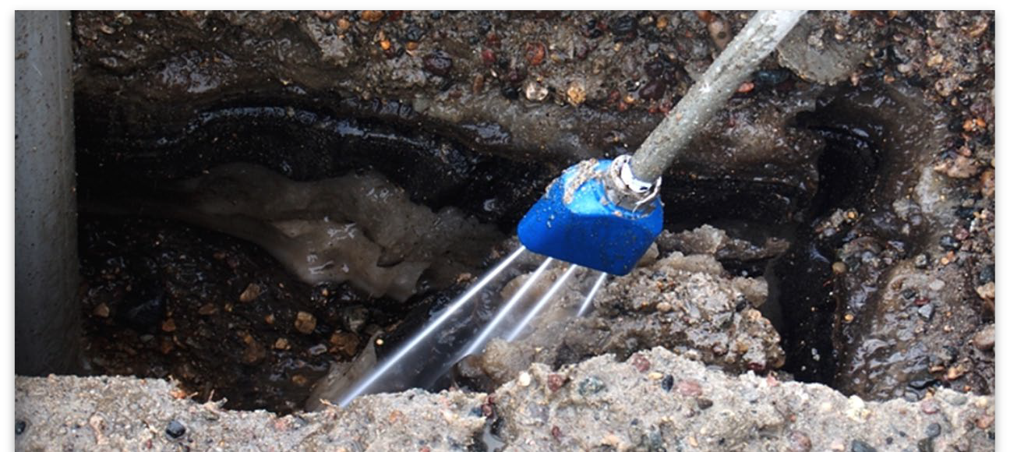
Advantages of Hydro Excavation
Can Dig in Virtually All Soils
Can Dig in Frozen and Hard Soils (boiler)
Water is a Lubricant
Eliminates sandblasting effect
Eliminates fugitive silica dust
Can be used for Alternate Applications
Highly Productive in virtually all Soil Conditions
Reduced excavation site restoration cost

Slide 10

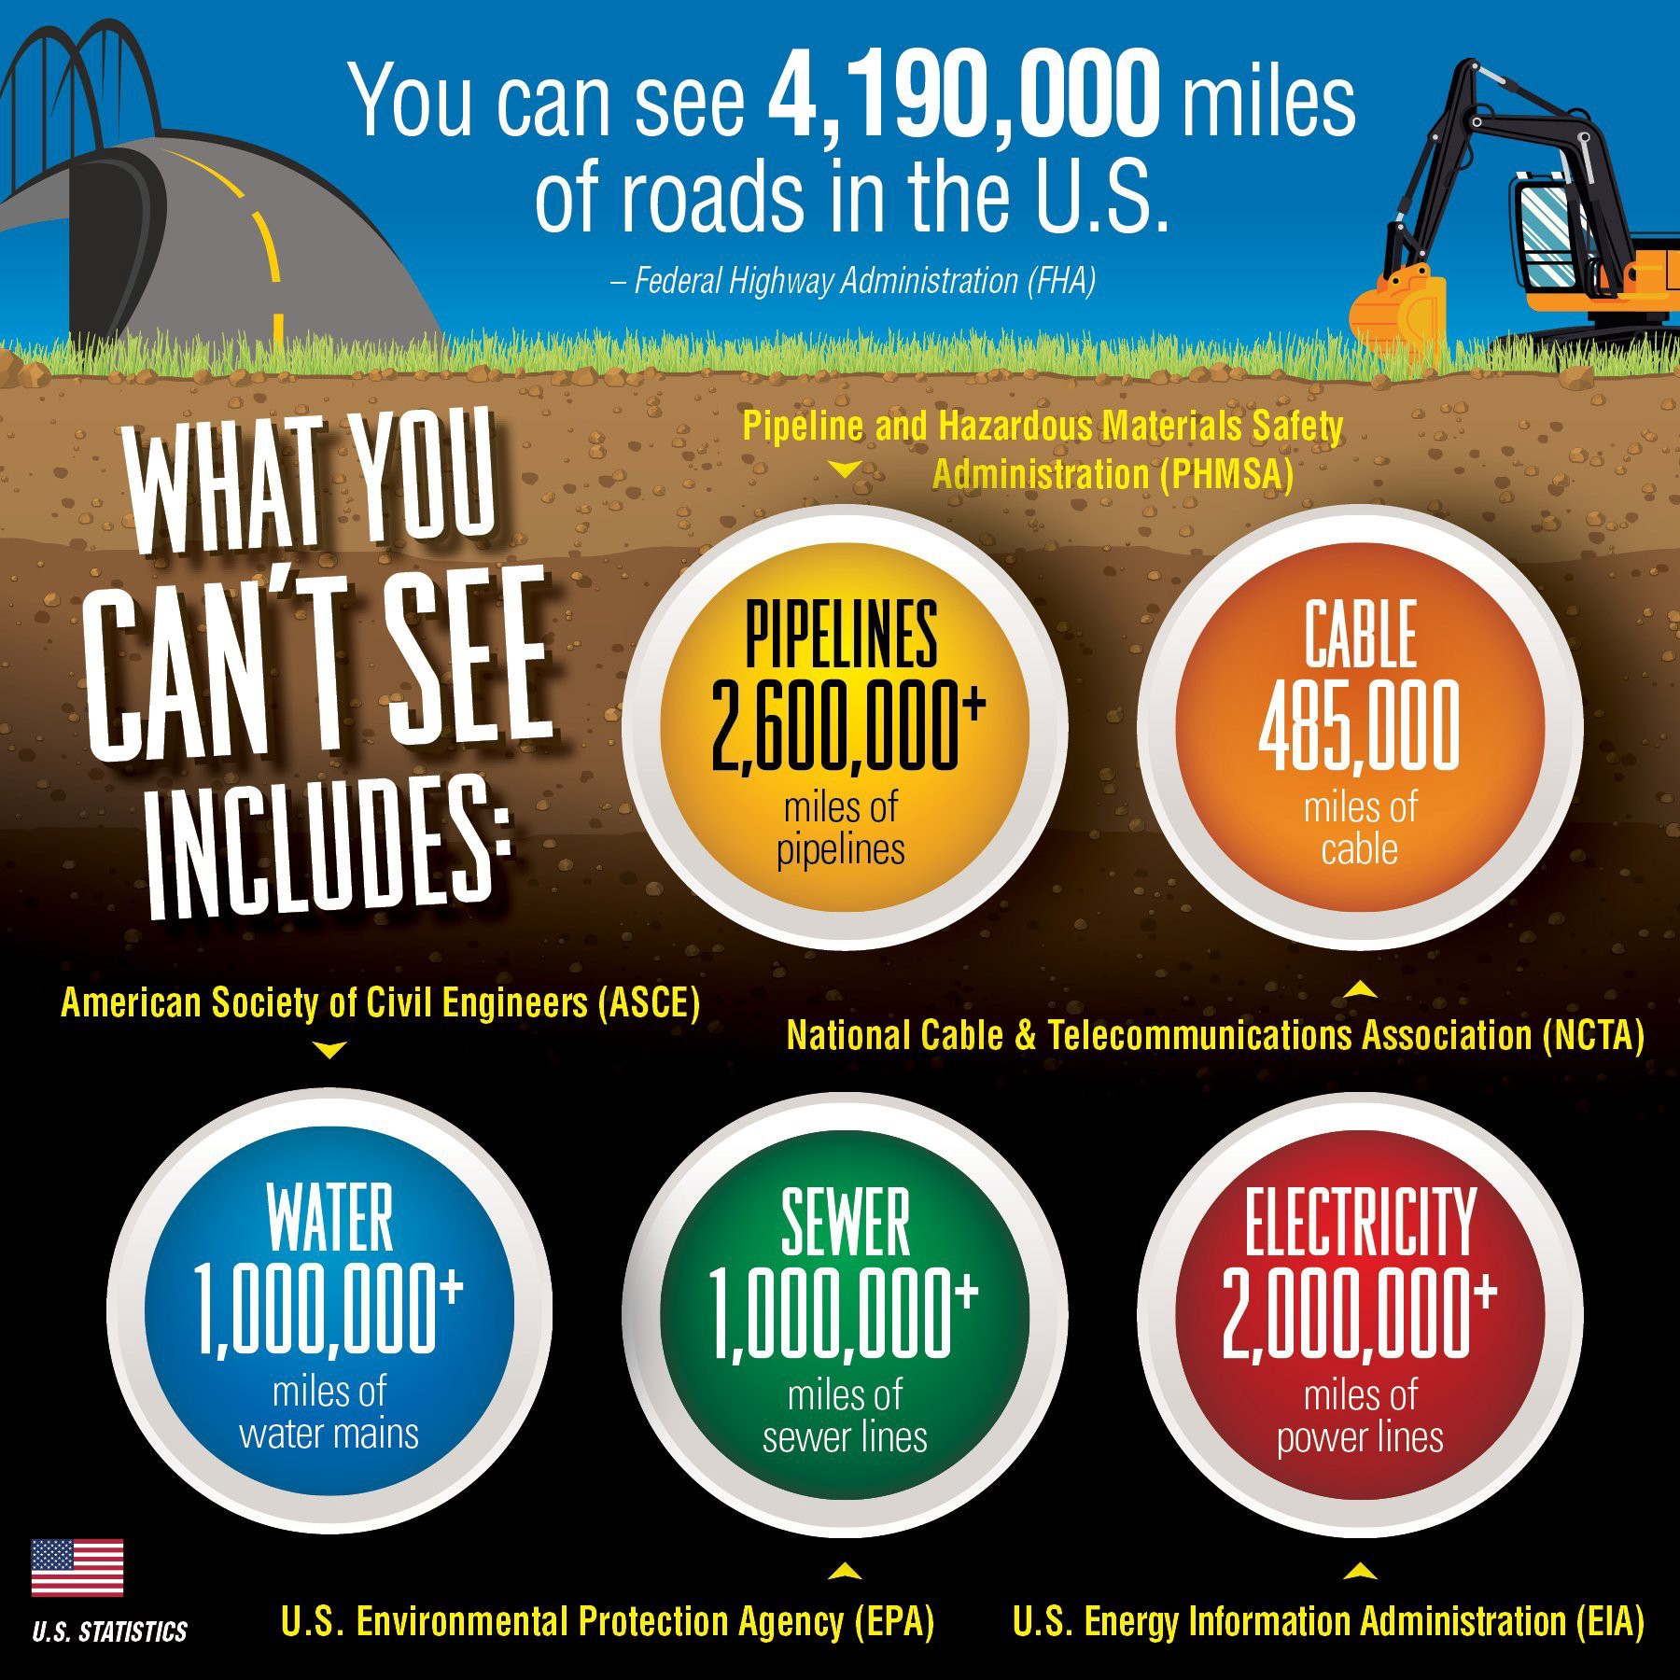

Protect Infrastructure
Over 1 BILLION feet of under ground utilities in the United States

Slide 11
100% visual verification
Why is visual verification so important?

Slide 12
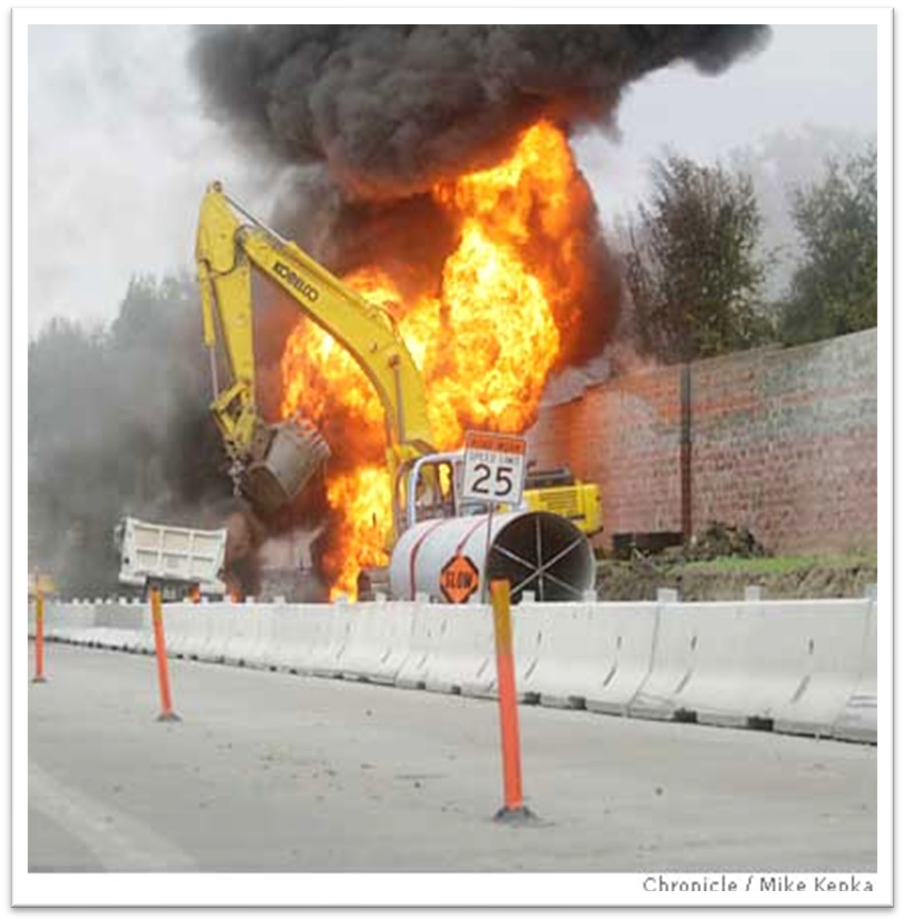
Call in a locate!
“In Walnut Creek, California on November 9, 2004, a petroleum pipeline carrying gasoline to San Jose, California, owned and operated by Kinder Morgan Energy Partners was
struck by a backhoe used by Mountain
Cascade Inc., a contractor operating in the construction of a water pipeline for the East Bay Municipal Utility District. A massive gasoline spill was subsequently ignited, resulting in an explosive fireball that caused the deaths of four workers and one supervisor and the severe injury of five people.
r t
A Kinder Morgan worker had misread an as-built map, and had incorrectly marked the pipeline's route before the accident.”
$90,000,000 IN FINES AND LAWSUIT SETTLEMENT

Slide 13
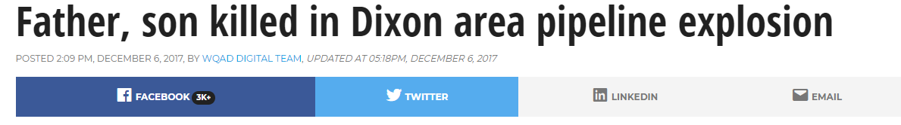
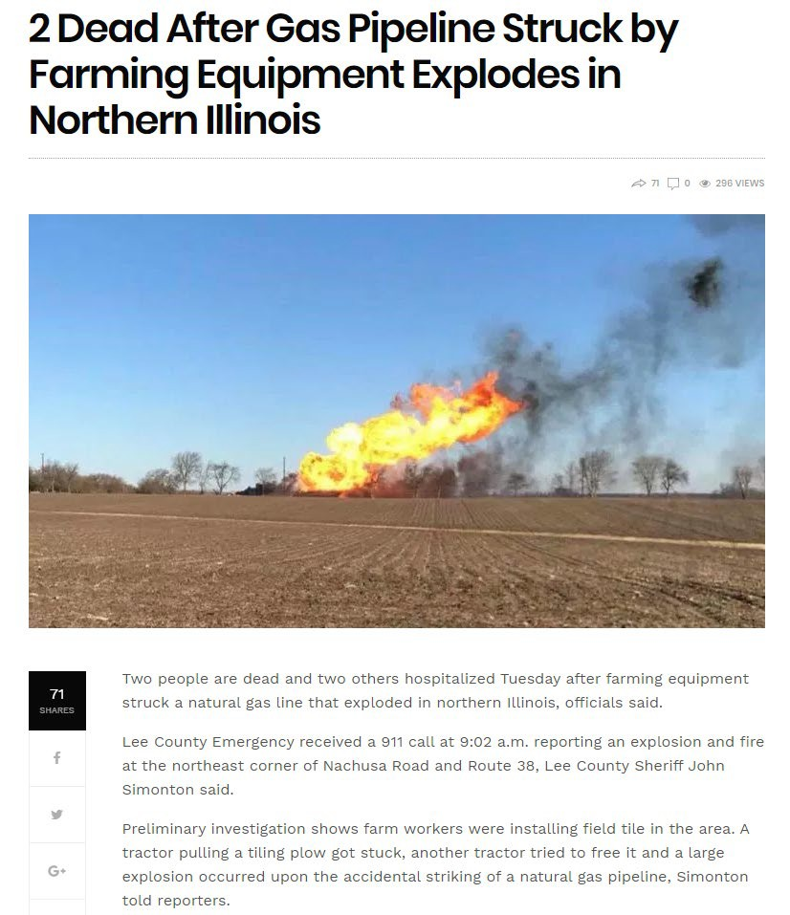
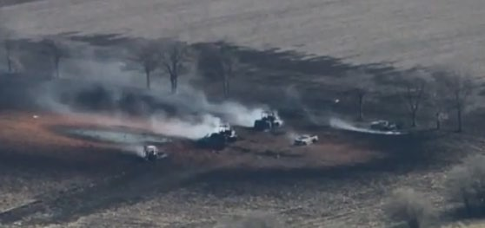
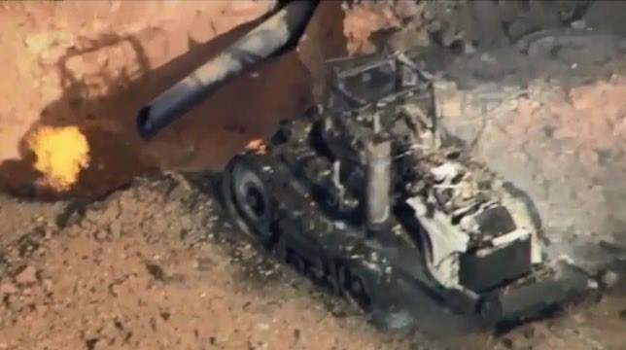
Natural gas pipeline
Dixon, IL

Slide 14
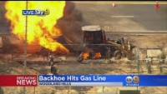
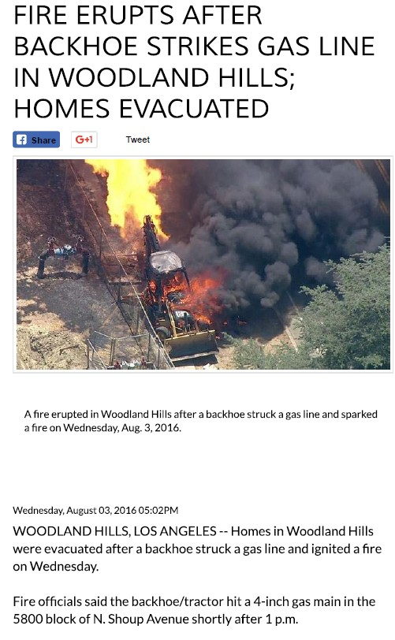
4” Gas Main

Slide 15
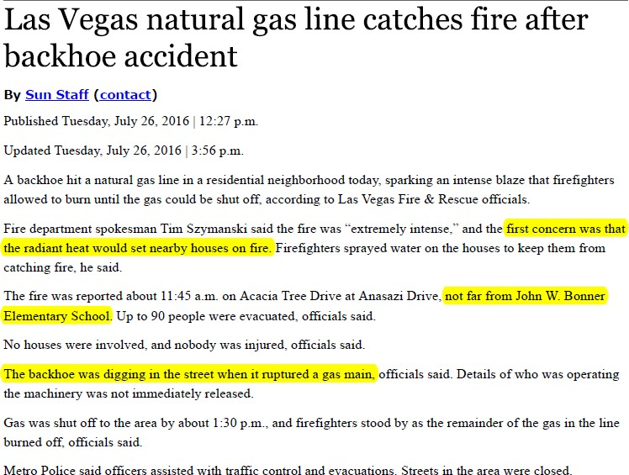

Protect People

Slide 16
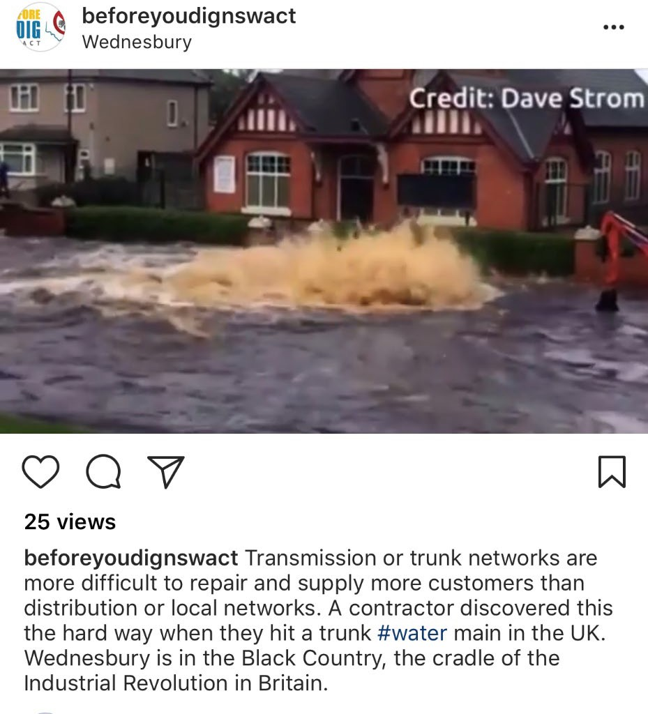
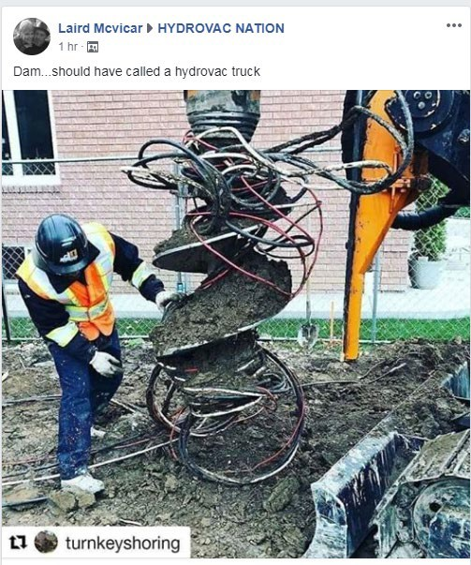
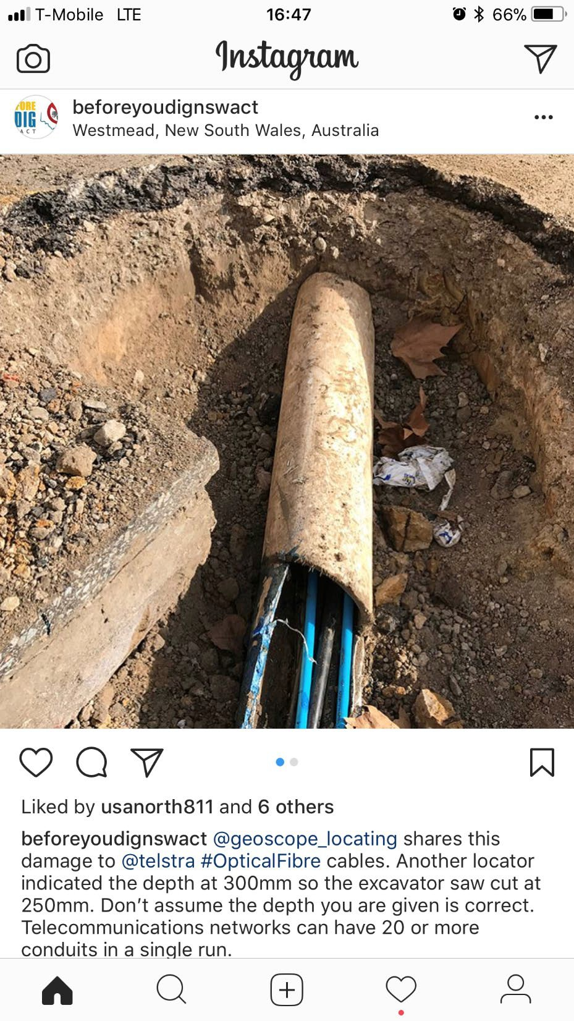
Protect Infrastructure

Slide 17
How many of these accidents could have been prevented with visual verification by Hydro Excavation?

Slide 18
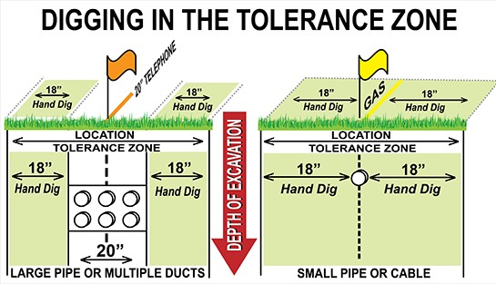
Tolerance Zones
811 regulations define a tolerance zone and acceptable excavation practices within this zone. Tolerance zones vary by state.
  Acceptable methods for safe digging are typically by-hand or soft digging (vacuum excavation). Check your state’s 811 handbook for more information

Slide 19
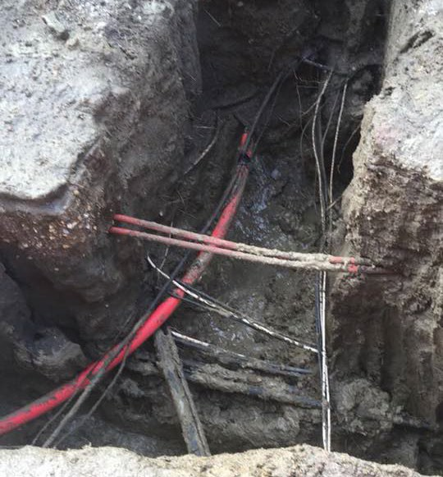
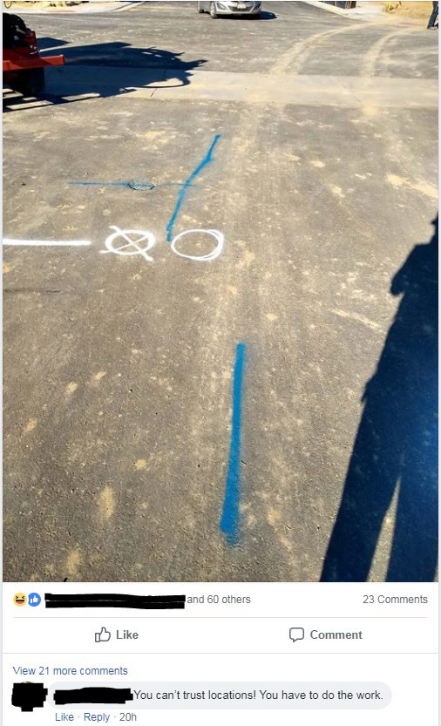
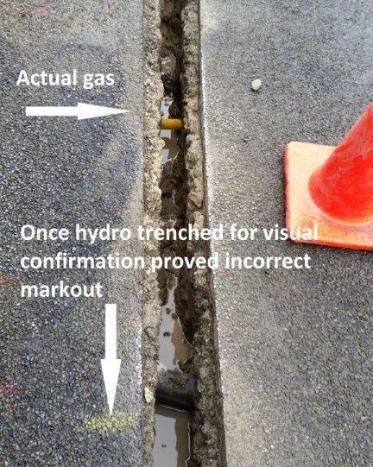
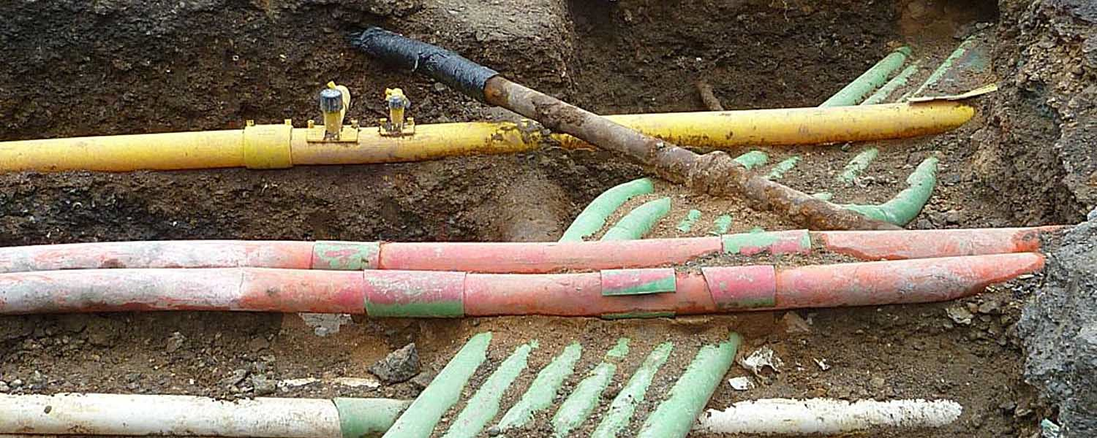
Miss/Not Marked Buried Infrastructure

Slide 20
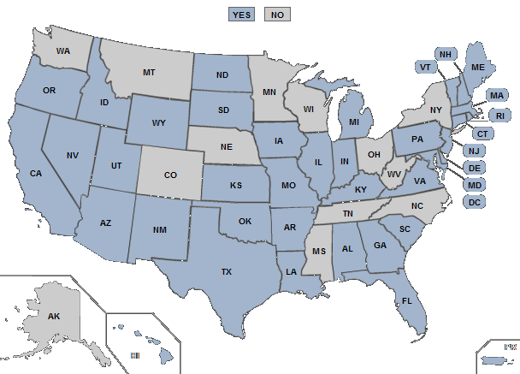
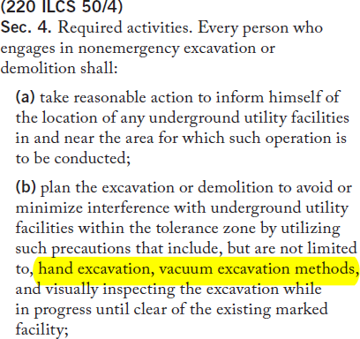
Regulations and Laws
States Requiring Hand Dig or Soft Dig in Tolerance Zone
Illinois Compiled Statutes
220 ILCS 50/4 – Required activities

Slide 21
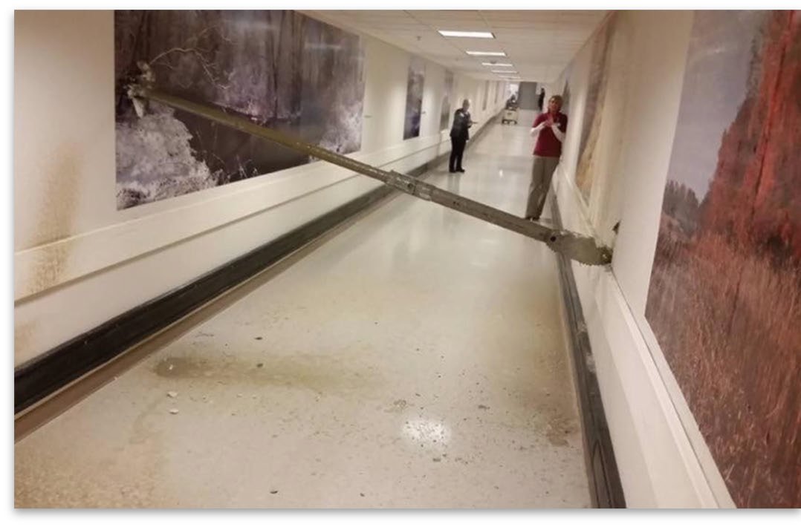
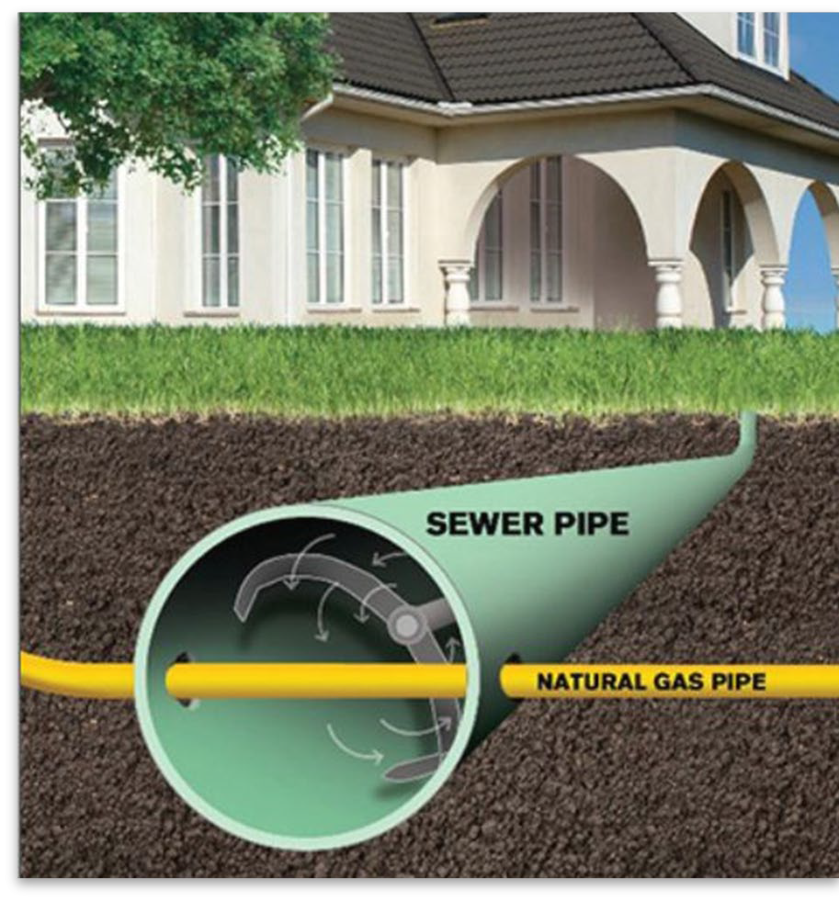


Regulation and Laws
OSHA’s focus on Safe Digging
  OSHA- “Reducing trenching and excavation hazards is currently their #1 goal”
  1926.651(b)(3) - When excavation operations approach the estimated location of underground installations, the exact location of the installations shall be determined by safe and acceptable means
    Vacuum Excavation, per OSHA, meets the “acceptable means”
16 States with legislative bodies that can deliver and enforce punishments for unsafe digging practices.
  More states considering
  Civil penalties are also a possibility
Regulations in certain areas/recommendations in others to visually verify utilities in HDD bore path and watch as bore head crosses

Slide 22

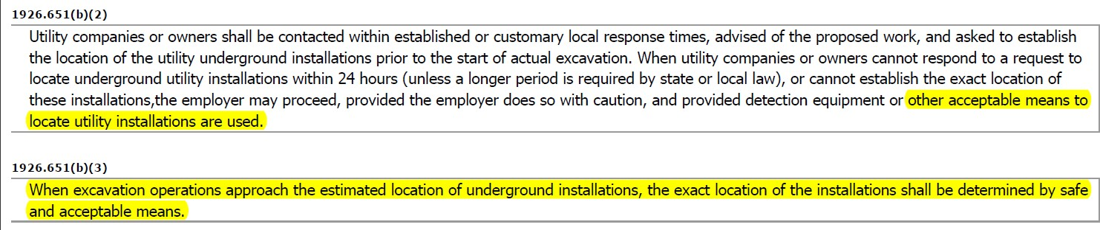
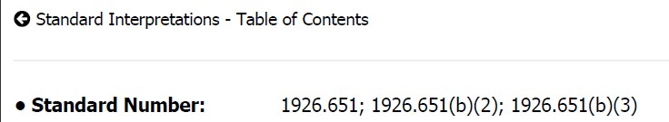
Regulation and Law
OSHA
  Specific Excavation Guidelines
    1923.651 Subpart P

Slide 23
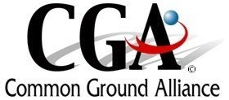

Stats About Strikes
Common Ground Alliance (CGA)
  Tracks reported strikes
    Causes, costs, utility impacted, etc.
  DIRT Report-Damage Information Reporting Tool
    Reports on past year statistics
811/1 Calls
  Work with CGA on tracking/reporting
Goal: determine causes of strikes to reduce likelihood at the source

Slide 24
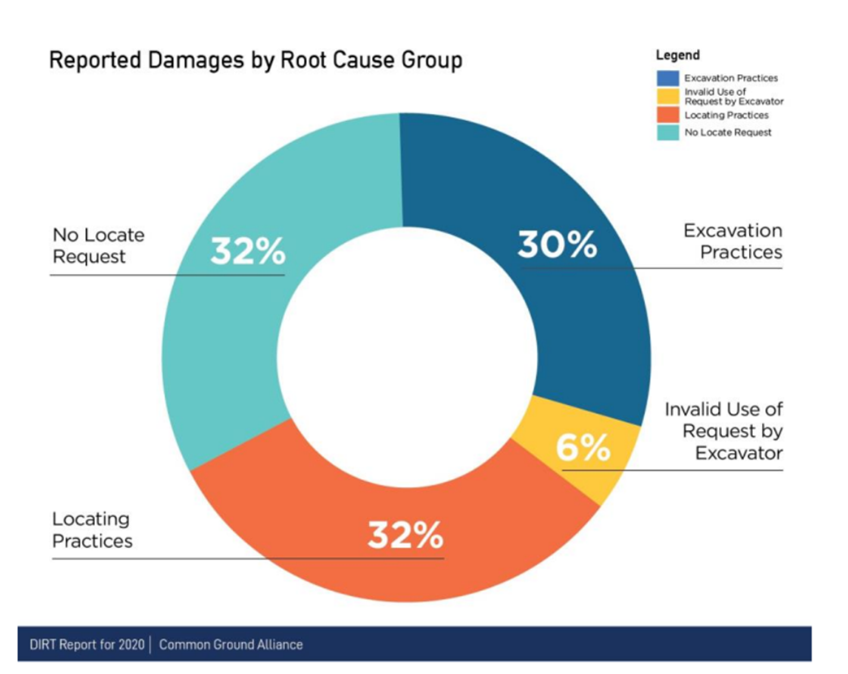
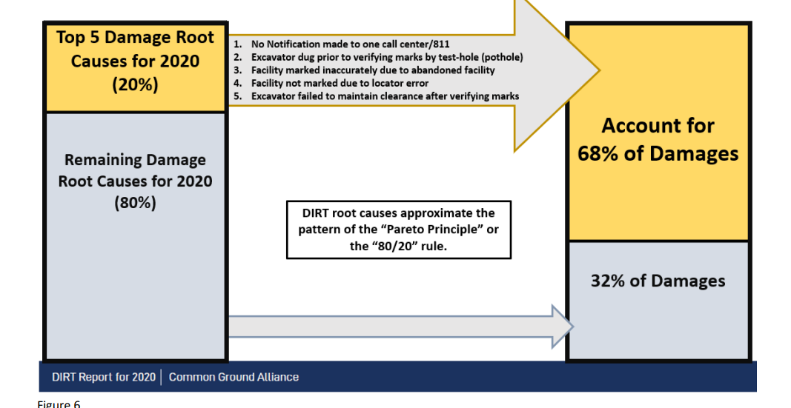
Stats
-
*Credit for picture to 2020 Dirt report

Slide 25
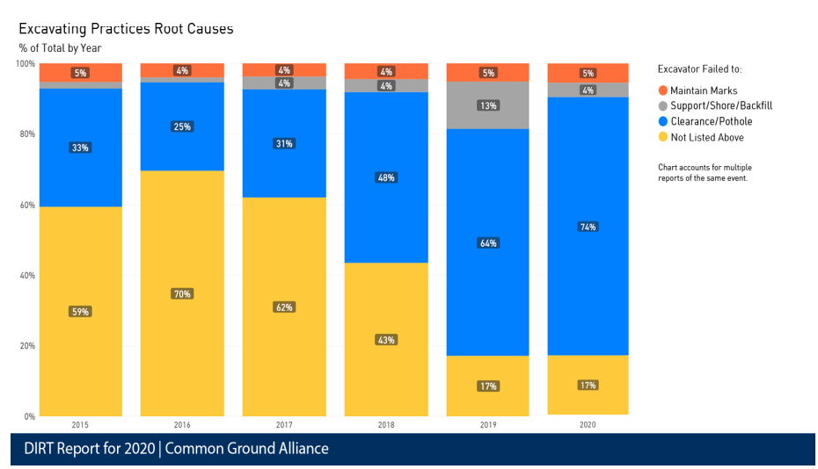

Stats

Slide 26
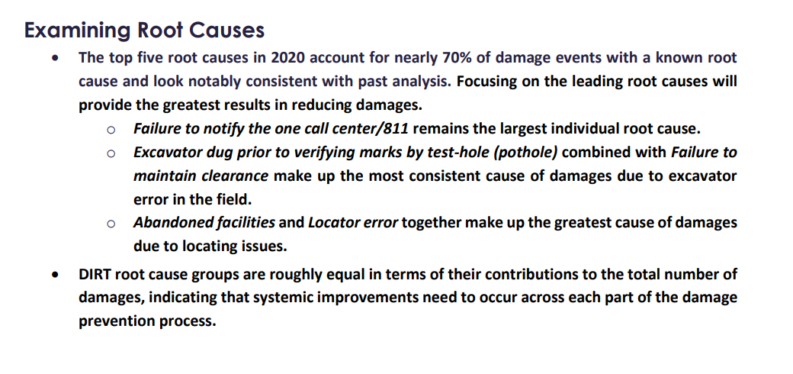
Stats
Credit to the Dirt report 2020

Slide 27
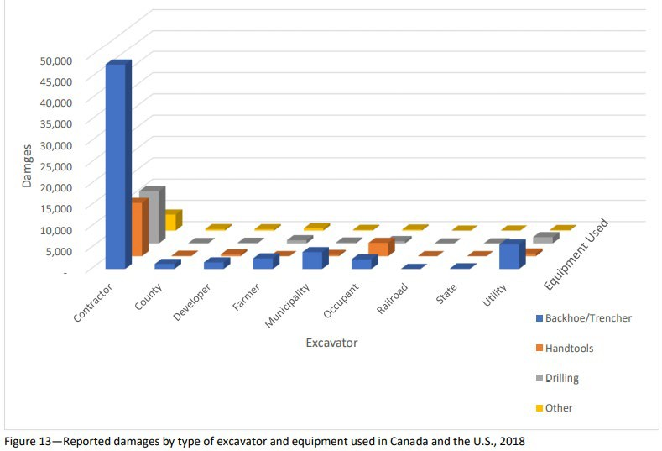
Stats
Notable Findings:
In 2018 vacuum excavators represent ~0.08% (268 total) of known unique strikes
In 2018 hand tools represent ~6% (20,333 total) of known unique strikes
In 2018 ~88% of strikes could have been prevented by using vacuum excavation (11.9% was “unknown” issue so it’s likely even more strikes would have been prevented)

Slide 28
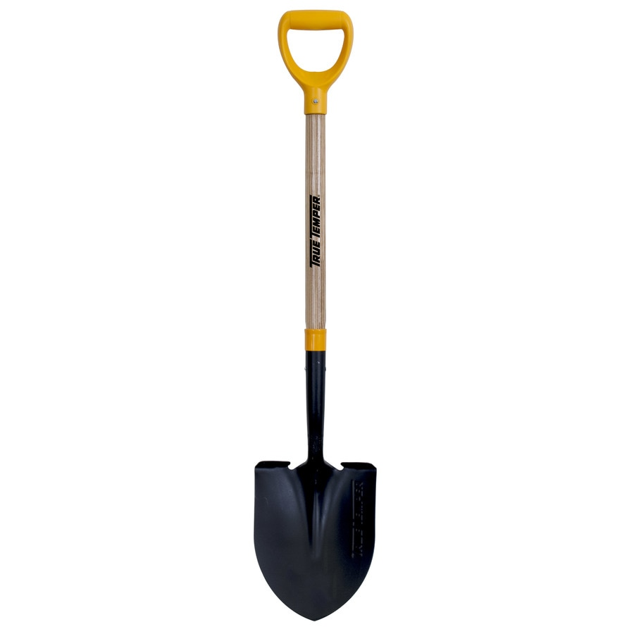
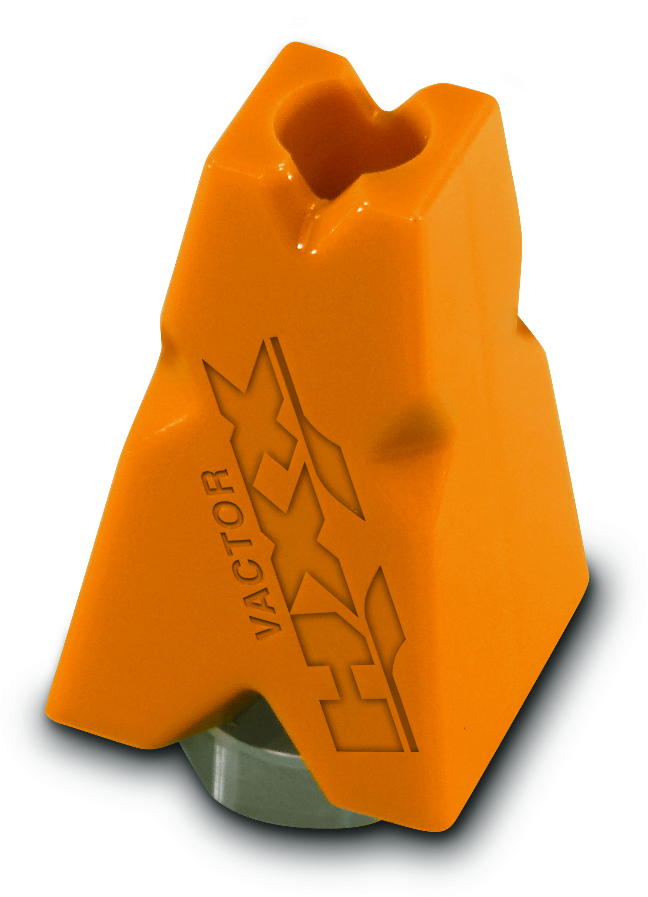
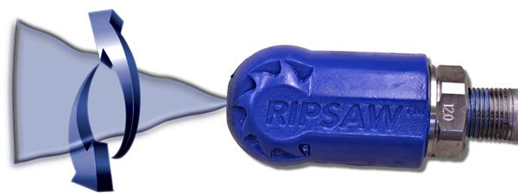
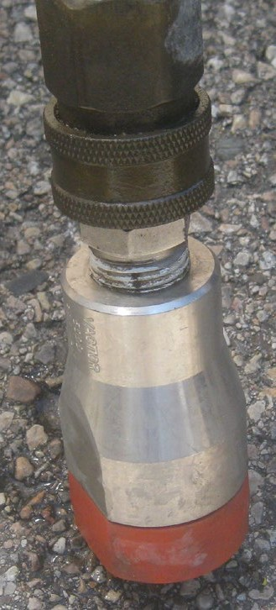
Shovel vs the High-Pressure HXX tip
VS

Slide 29
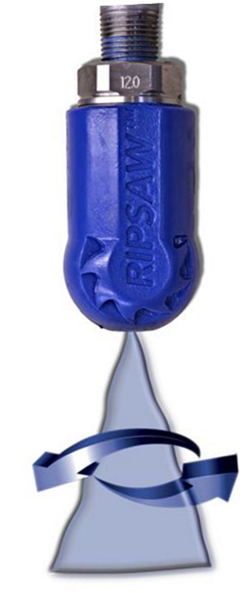


Stats
Results:
  Avg Force by Shovels = 688 lbs.
  Avg Force by Nozzles = 15.5 lbs.

Slide 30
Stats
Results:
  Avg Force by Shovels = 688 lbs.
  Avg Pressure by Shovels = 44,021 psi
  Avg Force by Nozzles = 15.5 lbs.
  Avg Pressure by Nozzles = 1260 psi

Slide 31


Stats
Results:
  Avg Force by Shovels = 688 lbs.
  Avg Pressure by Shovels = 44,021 psi
  At the point of contact, shovels exert almost 35X more pressure than nozzles!!!
  Avg Force by Nozzles = 15.5 lbs.
  Avg Pressure by Nozzles = 1260 psi

Slide 32




Best Practices-Electrical Safety Authority
ESA guideline for hydro excavation:
  Max pressure with a straight tip nozzle – 2,500 PSI
  1,500 PSI max pressure when below 18” of the road surface.
  Max pressure with a spinner (orbital) nozzle – 3,000 PSI
  An 8” distance shall be maintained between the end of the pressure wand nozzle and soil.
  A device capable of stopping the excavation on demand, such as a dead man trigger or valve, shall be installed on the wand

Slide 33

Best Practices-Gas Technology Institute
GTI guideline specifies pressure for hydro excavation (Same as TSSA’s) from Vacuum Excavation Best Practice & Guidelines:
  “When pressurized water wands are used, the maximum water pressure to be used at any time with a straight tip nozzle during excavation in public roads or easements shall be 2,500psi. Below a depth of 18” the water pressure to be used at any time with a straight tipped nozzle during excavation shall be reduced to a maximum of 1,500psi. All Vacuum Excavation Guidelines-Final pressure measurements are to be monitored using a pressure gauge mounted on the excavation machine.”

Slide 34

Best Practices-Gas Technology Institute
GTI guideline specifies pressure for hydro excavation (Same as TSSA’s) from Vacuum Excavation Best Practice & Guidelines:
  “The maximum water pressure to be used at any time with a spinning nozzle during excavation shall be 3,000psi. When a spinning tip nozzle is used, pressure measurements are to be monitored using a pressure gauge mounted on the excavation machine.”

Slide 35
Best Practices-Gas Technology Institute
GTI guideline specifies pressure for hydro excavation (Same as TSSA’s) from Vacuum Excavation Best Practice & Guidelines:
“The pressurized air or water
wands shall never remain motionless during
excavation. Aiming directly at the underground facilities shall be avoided at all times.”
“A distance of 8” shall be maintained between the end of the pressure wand nozzle and the underground facility and / or subsoil. The nozzle shall never be inserted into the subsoil while excavating within the “tolerance zone”.”
“A device capable of stopping the excavation on demand, like an Emergency Shut-off Device, shall be immediately available at the point of excavation”

Slide 36


Sewer

Slide 37


Send in the root cutter!

Slide 38


Even better!

Slide 39




Cross bored utilities
Mechanical root cutter ??

Slide 40


Locate or jet with a nozzle first

Slide 41





High pressure gas line

Slide 42


Slide 43


Return on Investment
Subsurface Utility Engineering (SUE)
Utility mapping utilizing different quality levels based on risk
Quality Level A is visual verification via vacuum excavation
In 2012 a Penn DOT study found that up to $11.39 can be saved in damage prevention for every $1 invested in SUE.
The top cost savings that were found are as follows:
40.33% reduction in project relocation cost by providing accurate underground information in the early stages of design
29.46% reduction in construction and design costs - SUE enables designers to design efficiently and accurately with reliable information, so that design time can be saved, and unnecessary construction work can be avoided or reduced.
9.59% reduction in redesign costs
Article Author: Geoff Zeiss

Slide 44
Uses for Vacuum Excavators
Light Pole Installation Directional Drilling Mud Recovery Potholing/Daylighting | Valve Box Cleanup Catch Basin Cleaning Portable Toilet Cleanup
Safe Excavation around Utilities
Water Main Repair
Recovery of Material
Cleaning of Lateral Lines
•
Pit Cleaning (Car Wash, Elevator, etc.
•
Lift Station Cleaning
Electrical Fault Repair
Culvert Cleanout
Utilize as a Water Truck
Natural Gas Extraction
Cathodic Protection
Service Cut-Off
Connecting Service Tee or Lateral
Pipeline Inspection
Pressure Testing
Slot Trenching
•
Fence Installation
Telephone Pole Installation and Removal
Anode Replacement
Large Excavations
Water Valve Exercising
Water Valve Replacement
Gas Line Repair/Shutoff
Fire Hydrant Maintenance
Excavation around Tree Roots
•
Frozen Ground Excavation
•
Spill Cleanup
Fiber Optic Repair
Sand Filtration System Cleanout
Vacuum Roof Rock
Telephone Line Repair
Vault/Hole Digging
•
Street Sign replacement
And More!

Slide 45


Trench Collapse Rescue

Slide 46



.
Thank you for your time. Are there any questions?

Slide 47

Tips-Weight
Material type and water usage can impact how much debris you can carry.
  Typical weights per cubic yard per engineering toolbox
    Dry dirt ~ 1900 lbs.
    Dry sand ~ 2375 lbs.
    Mud ~ 2820 lbs.
    Wet gravel ~ 3060 lbs.
  Volumetric capacity doesn’t necessarily mean max legal capacity
  Your specific application determines best configuration

Slide 48



TIP: Hydro Excavation kits can be added to your existing combination sewer cleaners. (in most cases)

